Slide 1
The Household as Nexus
The Domestic Nexus: Workshop 1
University of Sheffield
15 October 2015
Zoë Sofoulis
Institute for Culture and Society
Western Sydney University

Slide 2
The Household as Nexus
Household as network(ed) node
  a point of service delivery and consumption for numerous networks (including water, energy, IT)
Household as a network or assemblage
  differentiated personae and performances within
Household as a community nexus
  Members belong to various, partly overlapping networks.

Slide 3
1. Household as network(ed) node
Critical question: is the household –as unit of supply – also the most appropriate unit for targeting initiatives to change consumption practices (i.e. unit of demand)?
  Studies query notions of average consumers and consumption
  ‘Scaling up’ to cluster studies
Notes:
Shove E and Medd W 2007, Sociology of Water Use, UK Water Industry Research Ltd
Alison L Browne & Will Medd & Ben Anderson 2012 .Developing Novel Approaches to Tracking Domestic
Water Demand Under Uncertainty—A Reflection on the “Up Scaling” of Social Science Approaches in the United Kingdom
Alison L Browne & Will Medd & Ben Anderson

Slide 4
2. Household as a network or assemblage
Gender – often black-boxed in notion of the ‘household unit’
Culture – assumed to be monoculture but can be a multi-culture
  Era 1: home country; scarcity, diversity
  Era 2: Oz abundant provision
  Era 3: new scarcity and variability
Species (and other non-humans) – assemblage of humans and non-human consumers and practices
Notes:
Gender - Lahiri-Dutt, K. Ed. (2006) Fluid Bonds: Views on Gender and Water, Stree, Kolkata, p.xxx.
Culture - Sofoulis, Z., and Williams, C. (2008) From Pushing Atoms to Growing Networks: cultural innovation and co-evolution in urban water conservation, Social Alternatives 27(3): 50-57.
Strengers, Y. and Maller, C.J. (2012) Materialising energy and water resources in everyday practices: insights for securing supply systems Global Environmental Change, 22(3): 754 – 763 http://dx.doi.org/10.1016/j.gloenvcha.2012.04.004
Species - Yolande StrengersLarissa Nicholls and Cecily Maller, 2014, Curious energy consumers: Humans and nonhumans in assemblages of household practice, Journal of Consumer Culture, http://joc.sagepub.com/content/early/2014/05/25/1469540514536194 .

Slide 5
3. Household as a community nexus
Each member in the household may belong to a number of more or less extended networks.
  One participant’s communities included: the Sydney and national theatre scenes, a motor-home community that meets both online and in places around Australia, an international service organisation, friends originally formed through a Parent Teachers Group, and the local gym “where a real community exists and people discuss and exchange views on a wide variety of issues”.

Slide 6
Household - a node in many networks?

Slide 7
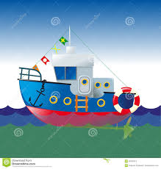
Household ‘unit’ as sealed ark

Slide 8

Household as porous sponge

Slide 9
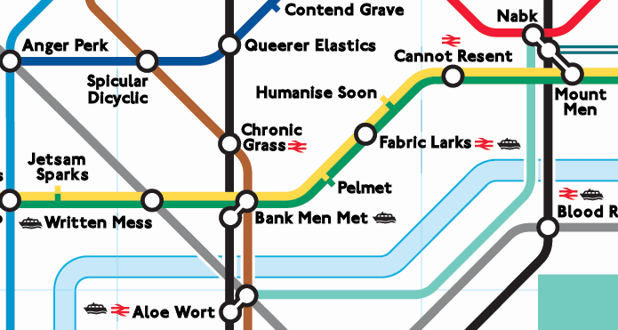
Household as transit station

Slide 10
Implications
Gregory Bateson (Steps to an Ecology of Mind): unit of biological survival is not the organism but the organism plus environment.
So address the household in terms of the contexts/ environment that hold it.
Possible interventions in household practice that don’t necessarily target the household directly, but work through organisations OUTSIDE the home.

Slide 11
Suggested programs
Not heterosexual consumer dyad but women’s friendship networks – e.g for decisions about household appliances.
Not bill enclosures but peer networks, social media, creative projects and role models for slightly drier program targeting teens laundry/ showering practices.
Not only top-down translation of corporate messages, but ‘bottom up’ translation of wise water sayings from community languages into dual language signage.
Notes:
This section not given in talk.
From project report: Sofoulis, Z., C. Williams, M. Campbell, and P. Rossiter. 2007. Demand management through
cultural innovation: User models: Final report. Centre for Cultural Research, University of
Western Sydney. (Project with Sydney Water Corporation.)

Slide 12
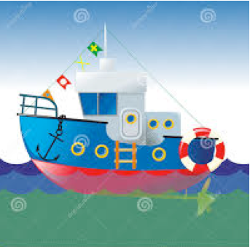
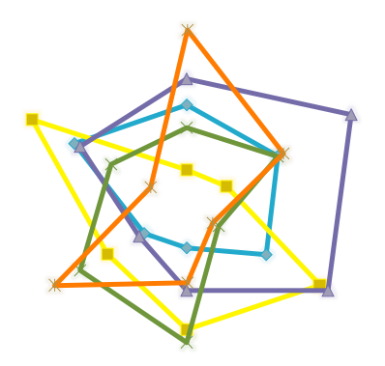

END
Thanks to:
Liz Sharp and Pennine Water Group
Matt Watson and Domestic Nexus project
Paul James, Dir., Institute for Culture & Society

